Slide 1
CSC 3210 Computer Organization and Programming
Dr. Zulkar Nine
Department of Computer Science
Georgia State University

Slide 2
Lab Work 1

Slide 3
Lab work 1 instructions
Lab 1(a) – Machine Setup and Microsoft Visual Studio installation (5 points)
Lab 1 (b) – Solve three math problems (5 points)
Lab attendance – (5 points)

Slide 4
Lab 1 (a)
Install Microsoft Visual Studio

Slide 5
Lab 1(a) - Instructions
The Lab Teaching Assistant (TA) will demonstrate the installation process of Microsoft Visual Studio on both Windows and Mac machine.
Task: (5 points)
Install visual Studio Community 2019
Submission Instruction:
Finish the installation of visual studio 2019
Run visual studio
Take a screenshot
Submit to the dropbox at iCollege

Slide 6
Lab 1 - Outline
Windows users –
Skip (Slide 8 to Slide 37)
Install Microsoft visual Studio (Slide 38 to Slide 46)
Mac OS users -
Microsoft visual studio does not provide all libraries for Mac OS.
Setup a virtual machine that can run Windows inside Mac OS
Slide 8 to slide 37
Install Microsoft Visual Studio inside your windows virtual machine ( Side 38 to Slide 46)

Slide 7
Lab Attendance
Write your name in the chat box : Attendance 5 points

Slide 8
Virtual Machine Setup (Mac OS)
Windows users do not need to do this
Windows users must skip Slide 8 to 37

Slide 9
Outline – Virtual Machine Setup (Mac OS user only)
Install Virtual Box in your Mac
Download Windows 10 ISO
Create a virtual machine (VM) in the Virtual Box
Install Windows 10 in the virtual machine
(You need at least 50GB free hard disk space)

Slide 10
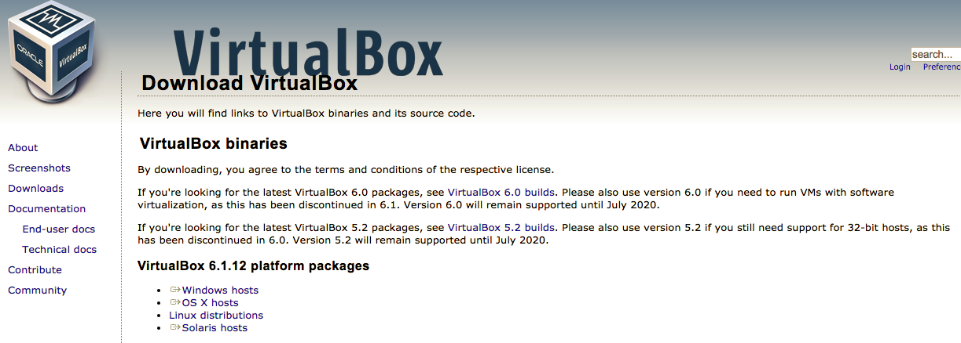
Install VirtualBox (1)
Go to https://www.virtualbox.org/wiki/Downloads
When finished, install the software
Download the package

Slide 11
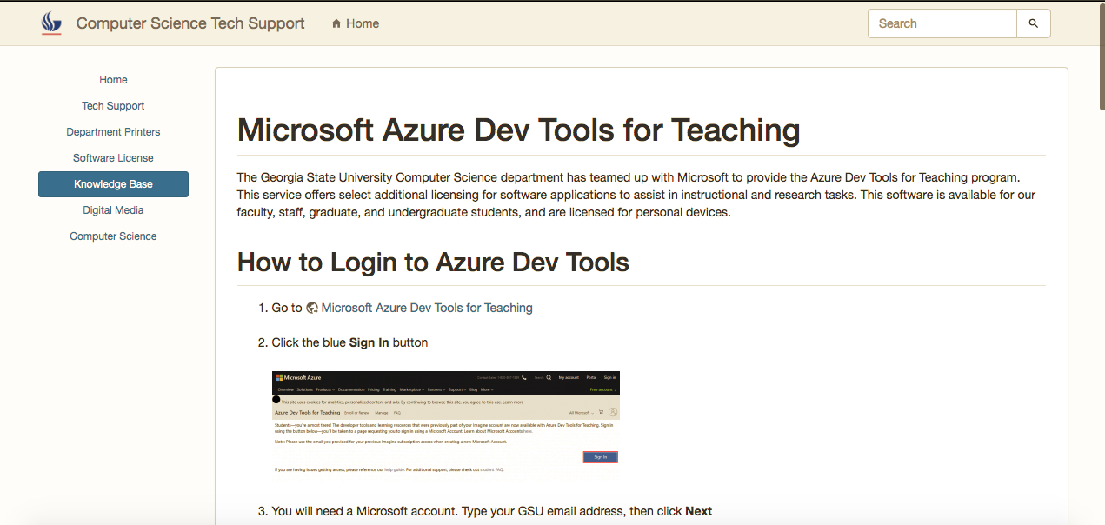
Download Windows 10 ISO (1)
Go to : https://cscit.cs.gsu.edu/sp/guide/msazure
Click
Microsoft Azure Dev tools for Teaching

Slide 12
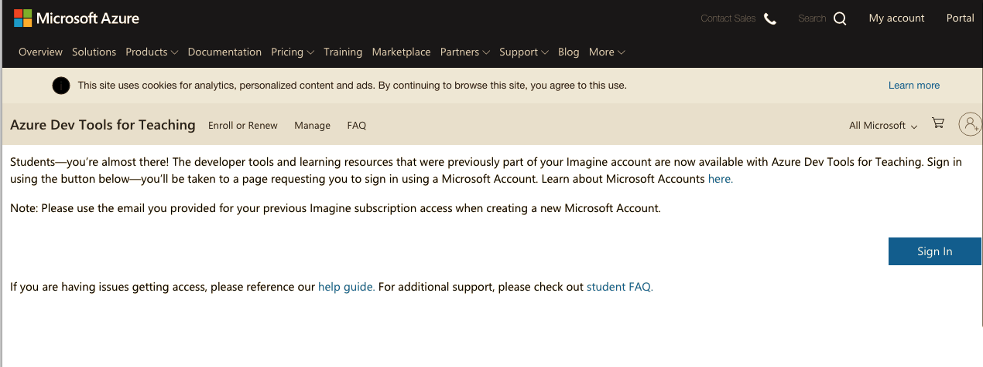
Download Windows 10 ISO (2)
Sign in with your GSU credentials

Slide 13
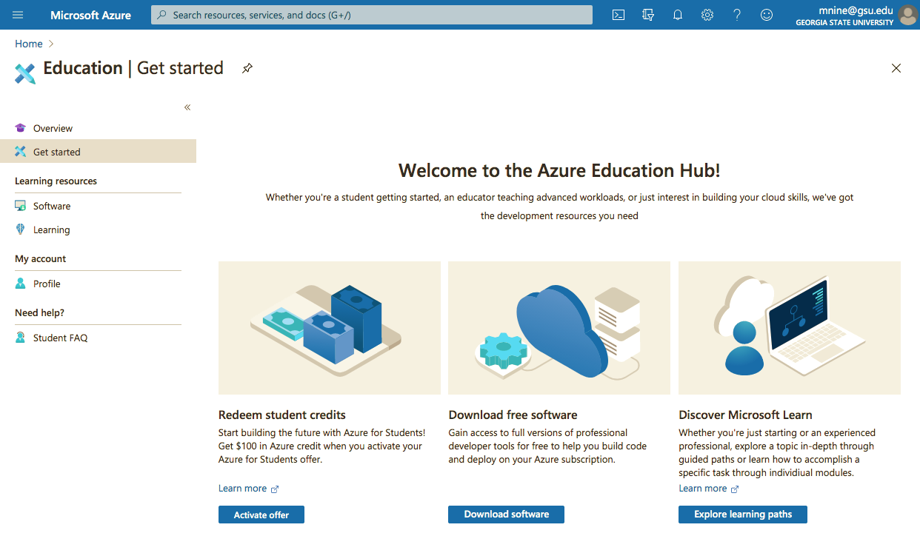
Download Windows 10 ISO (3)
Click on Download Software

Slide 14
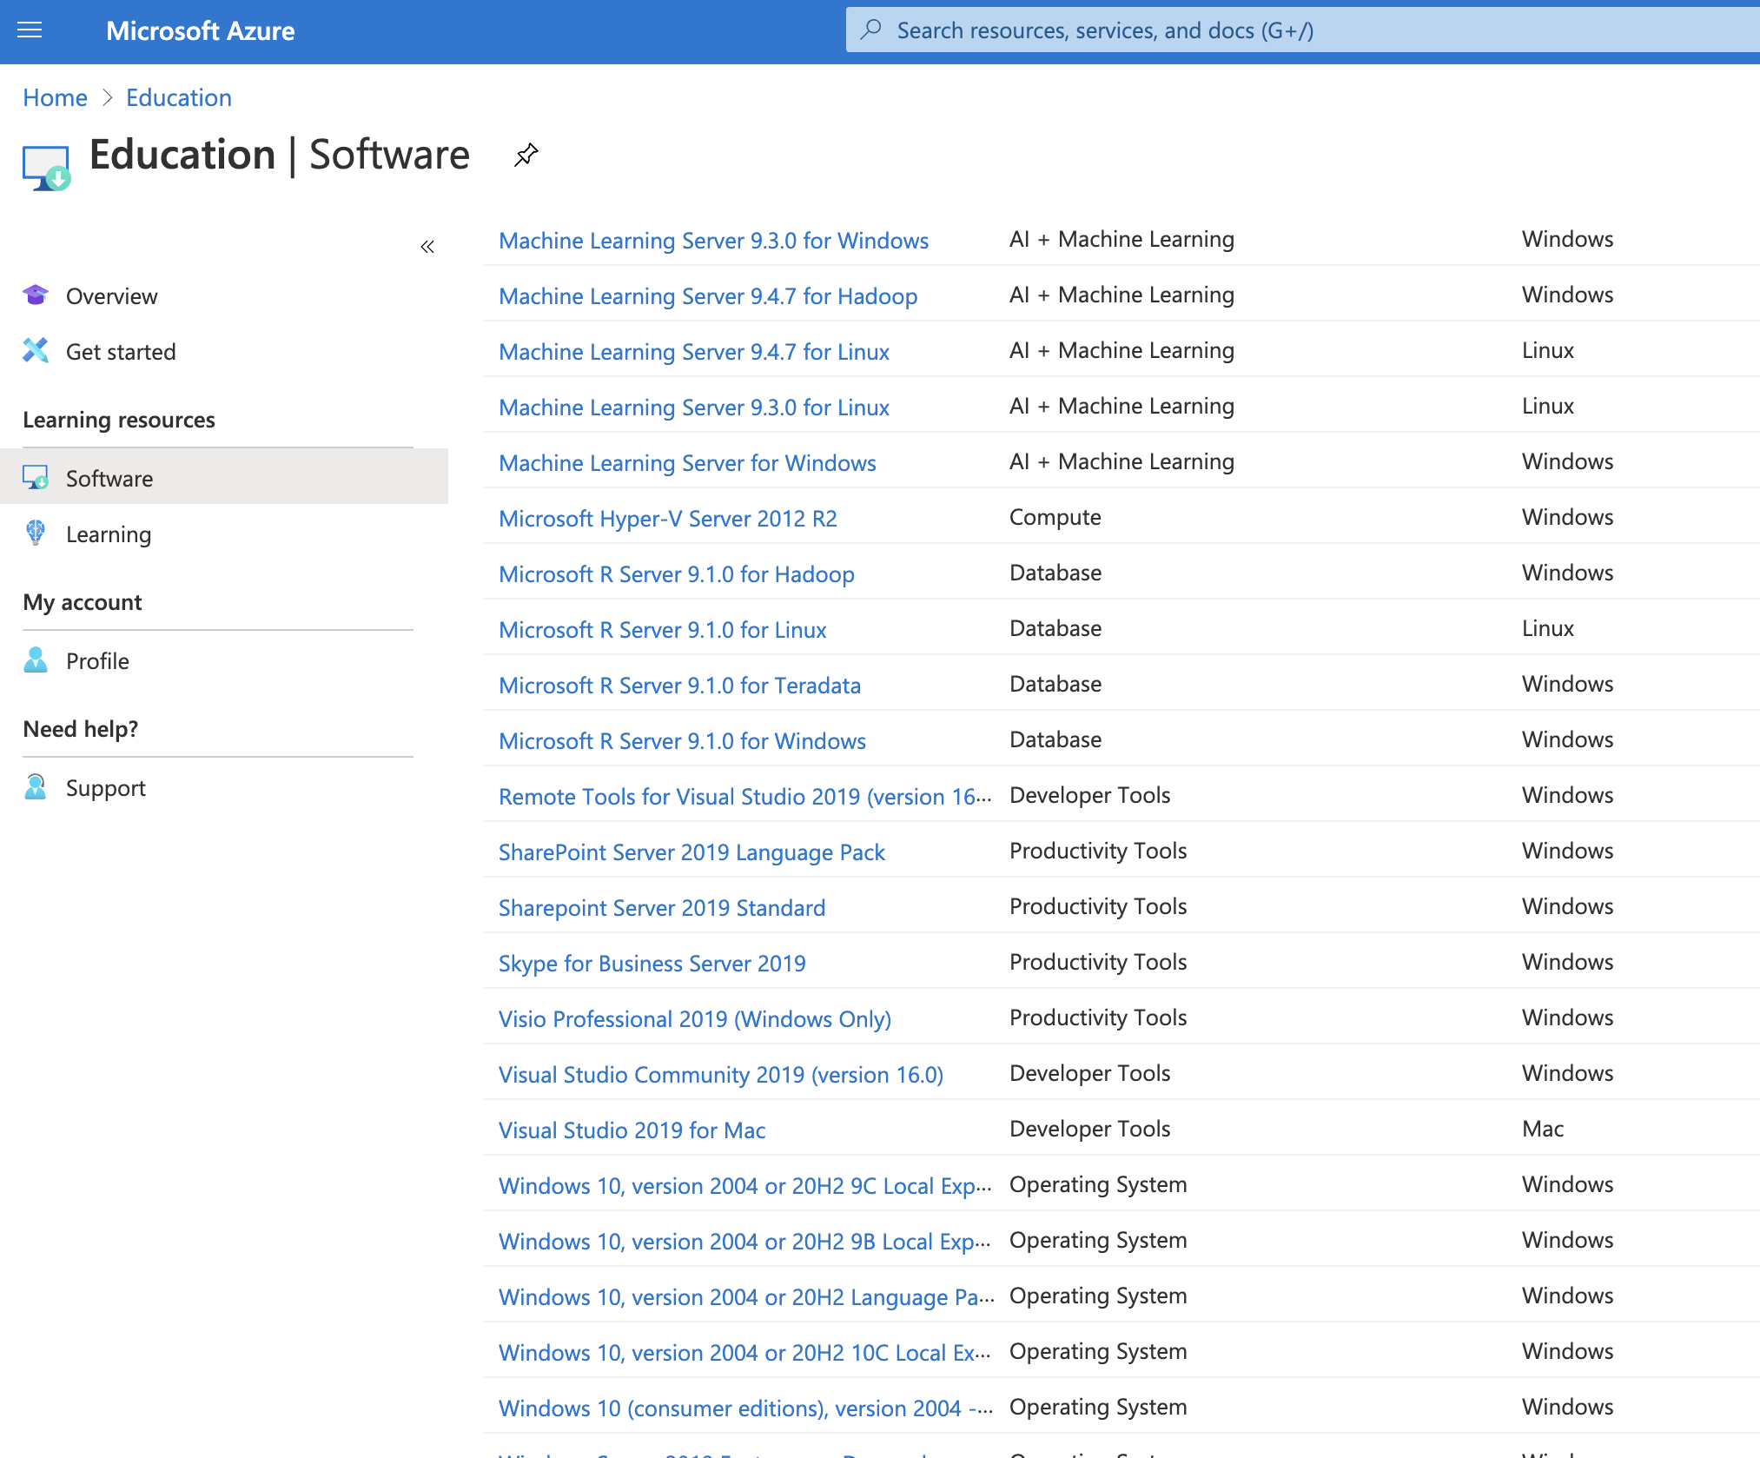
Download Windows 10 ISO (4)
Select Windows 10(Consumer editions) version 2004

Slide 15
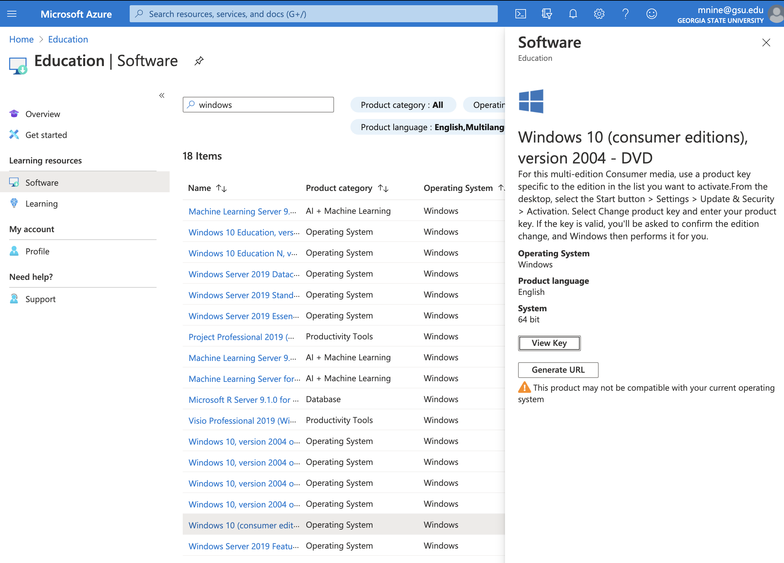
Download Windows 10 ISO (5.1)
Click Generate URL

Slide 16
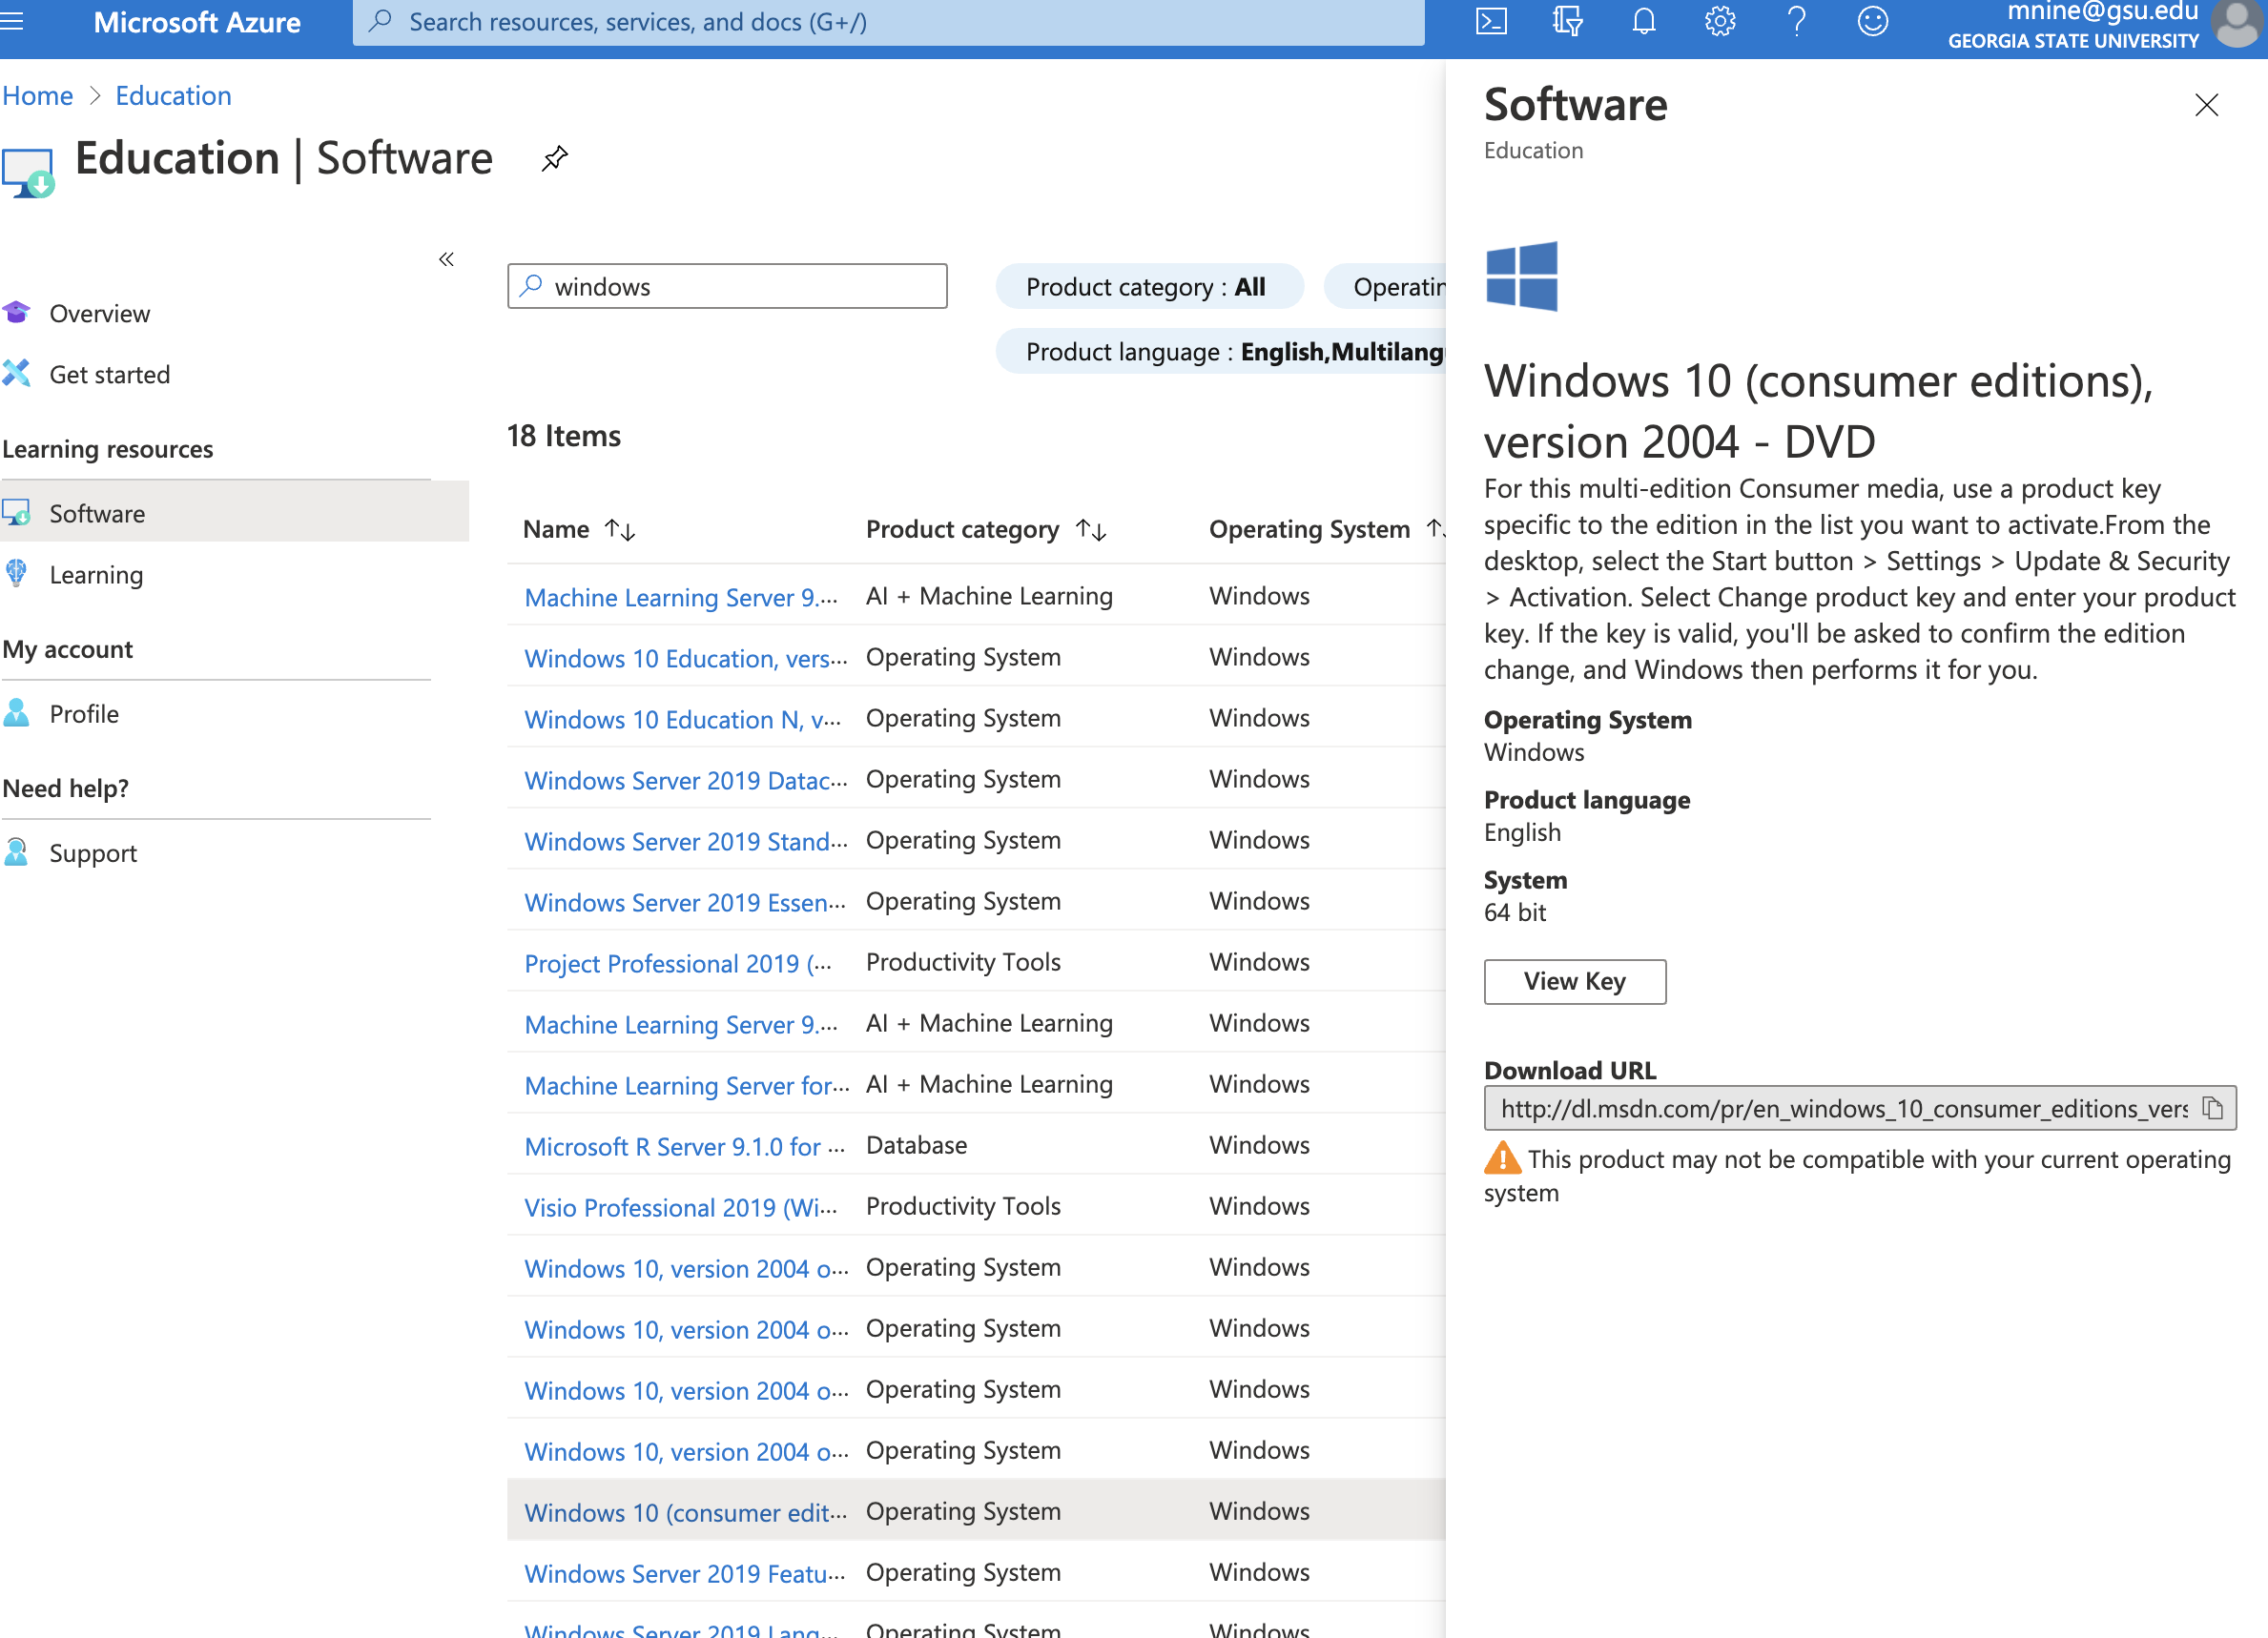
Download Windows 10 ISO (5.2)
Copy the URL into web browser to download windows 10

Slide 17
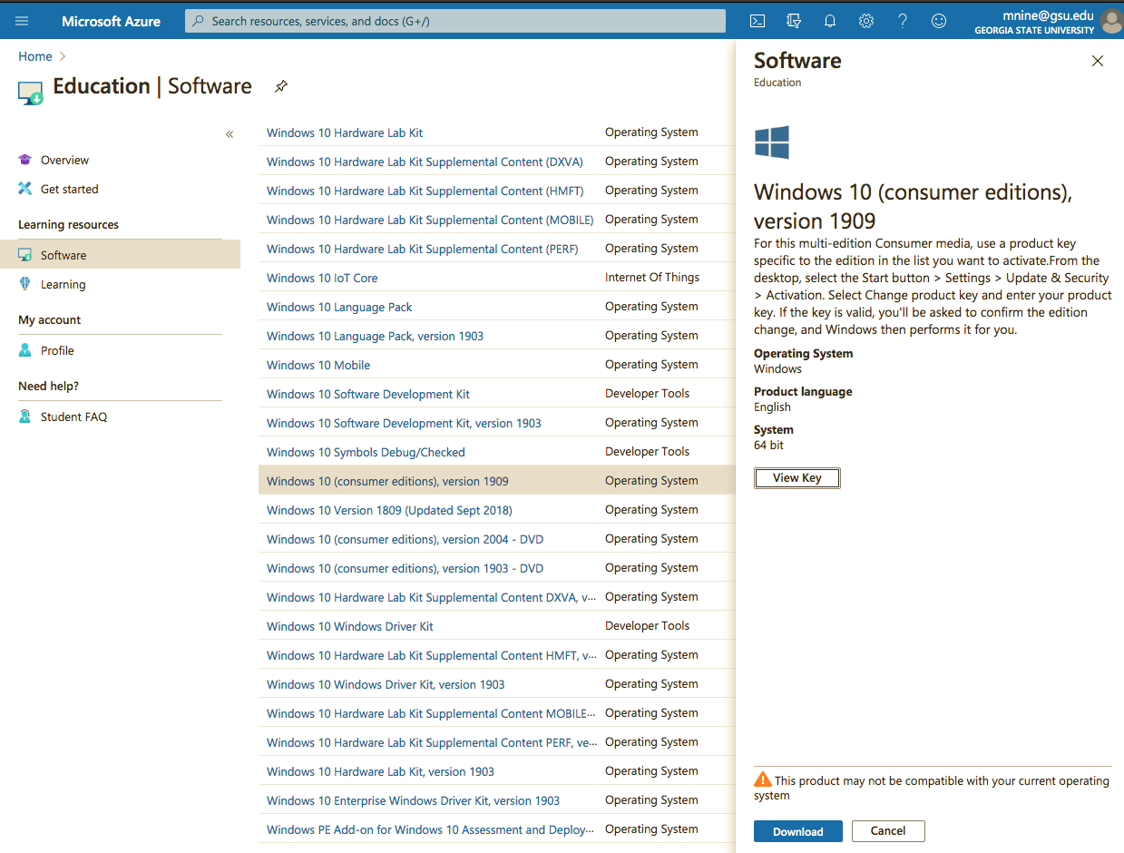
Download Windows 10 ISO (6)
Click View Key and Store the key in a text file

Slide 18
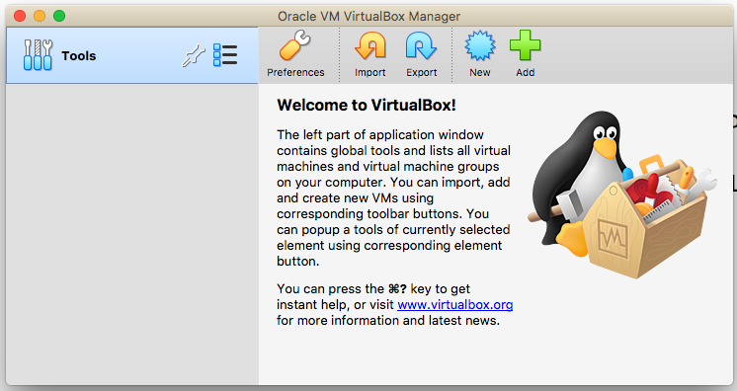
Create a virtual machine (1)
Create a new Virtual Machine
Open the Virtual box

Slide 19
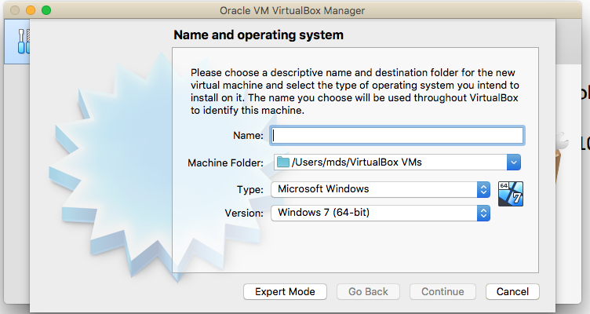
Create a virtual machine (2)
Make sure the “Type” is set to Microsoft Windows
And the version windows 10
64 bit means a 64 bit VM
X86 means a 32 bit VM.

Slide 20
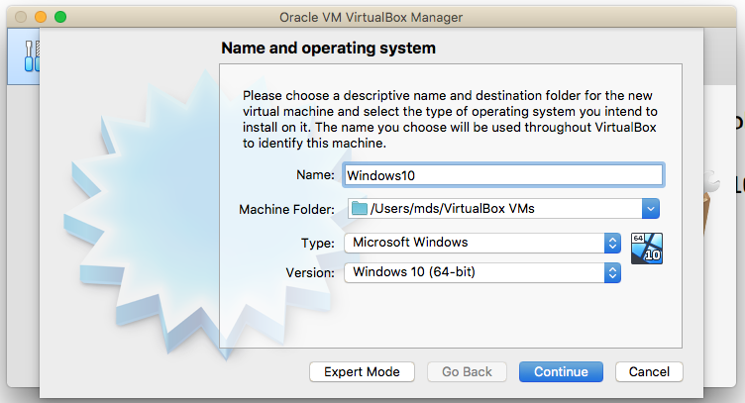
Create a virtual machine (3)
Name your VM
Make sure it is
Windows 10

Slide 21
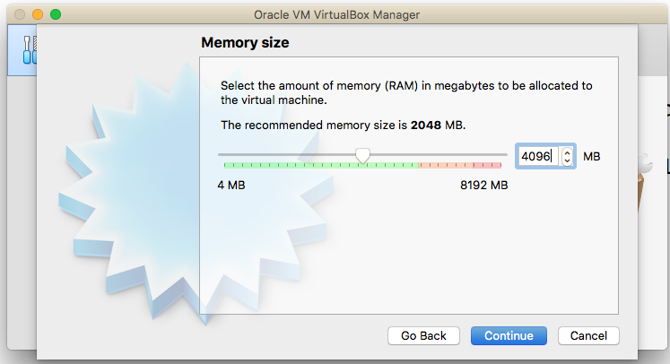
Create a virtual machine (4)
Select memory size
(4GB or more)

Slide 22
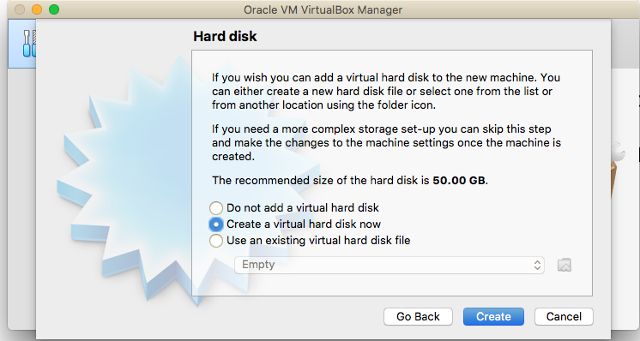
Create a virtual machine (5)
(1)Create a virtual hard disk of size at least 50 GB.
60GB is recommended.
Make sure that you have enough space in the hard drive
(2) Click Create

Slide 23
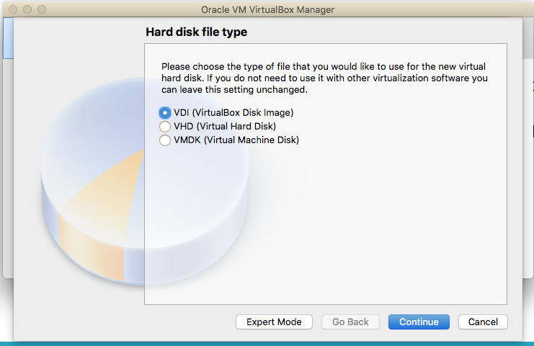
Create a virtual machine (6)
Click Continue

Slide 24
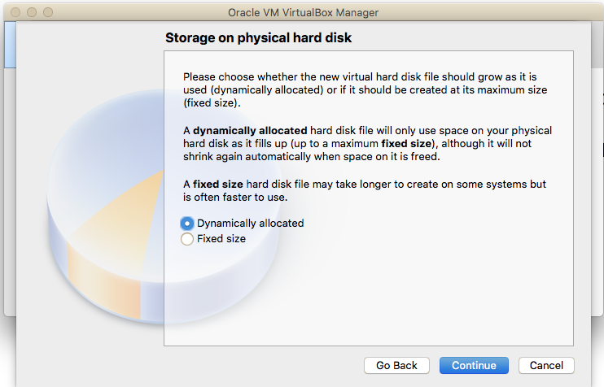
Create a virtual machine (7)
Click Continue

Slide 25
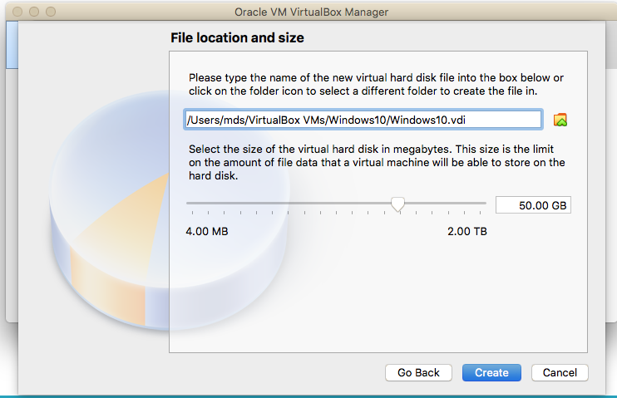
Create a virtual machine (8)
Click Continue

Slide 26
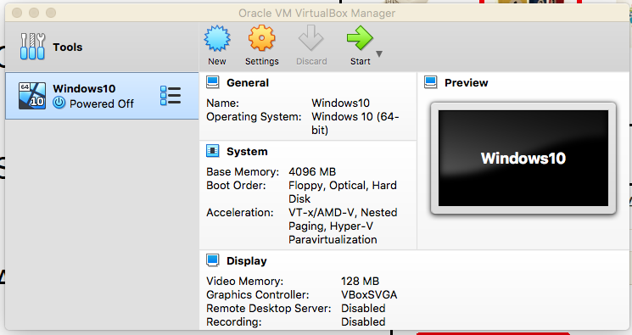
Install Windows 10 in VM (1)
Click on settings

Slide 27
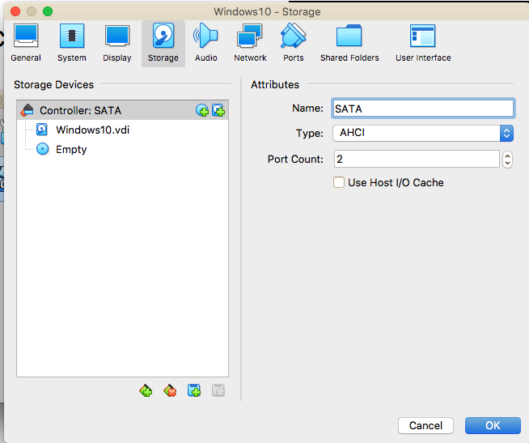
Install Windows 10 in VM (2)
Click the disk icon
Note : Here you load the windows iso file

Slide 28
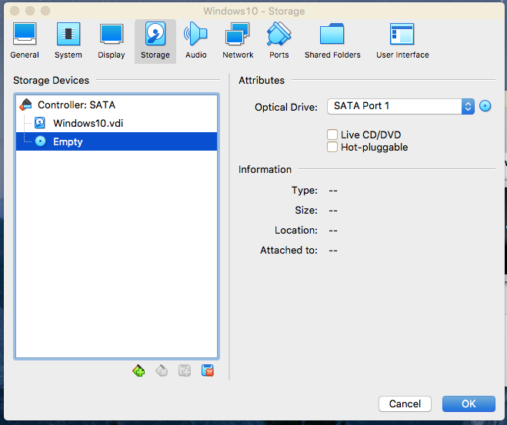
Install Windows 10 in VM (3)
Click the disk icon
Note: It will show you options to load Windows ISO file.

Slide 29
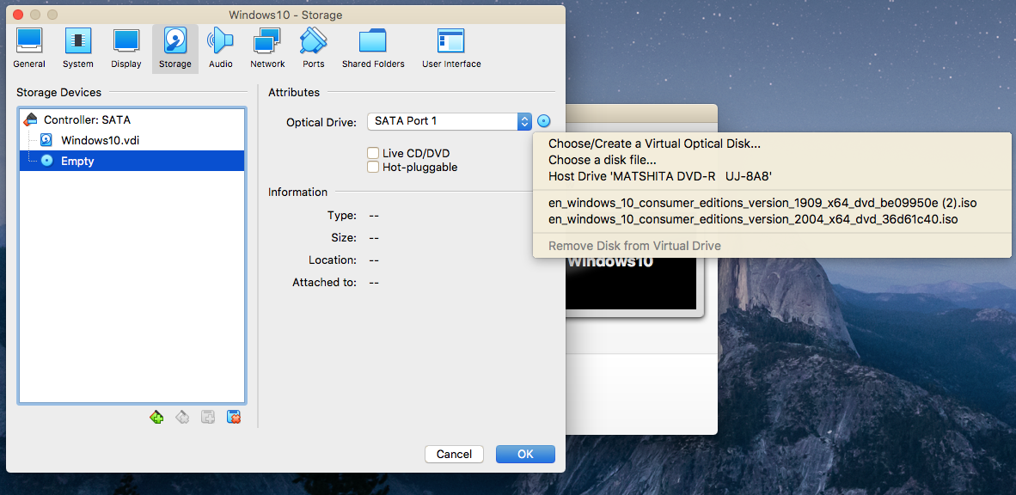
Install Windows 10 in VM (4)
Select the ISO file from the directory

Slide 30
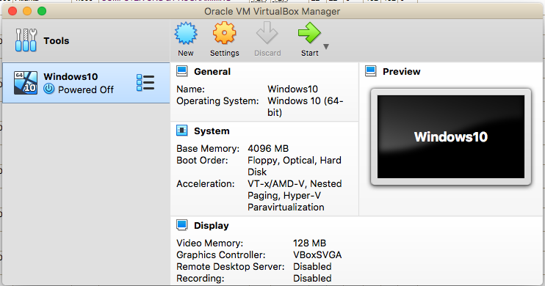
Install Windows 10 in VM (5)
Click settings
Note : Check the boot order

Slide 31
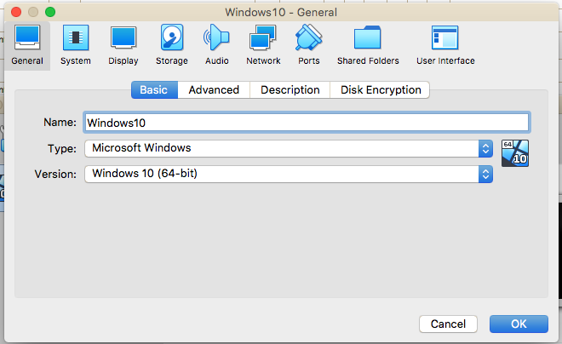
Install Windows 10 in VM (7)
Click System

Slide 32
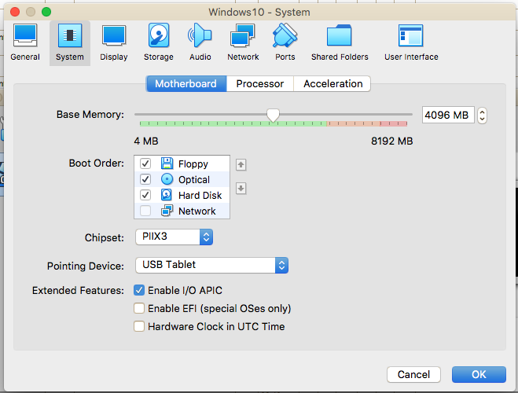
Install Windows 10 in VM (8)
Boot order should be like this.
If it is not like this, change the order by clicking the arrow signs (up, down) right to the list.

Slide 33
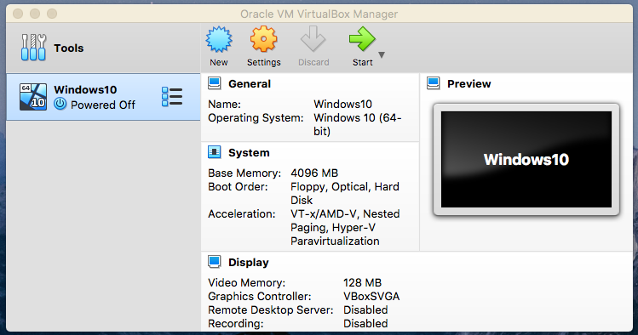
Install Windows 10 in VM (6)
Start the Virtual machine

Slide 34
Lab Attendance remainder
Write your name in the chat box if you didn’t do it first time : Attendance 5 points

Slide 35
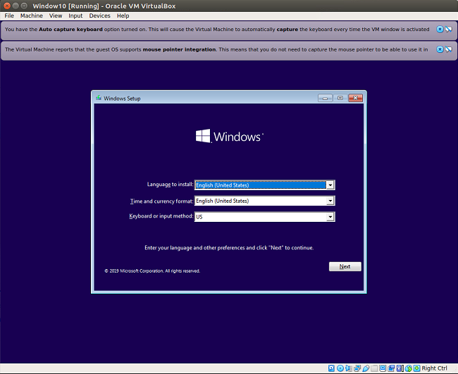
Install Windows 10 in VM (9)
Click Next

Slide 36
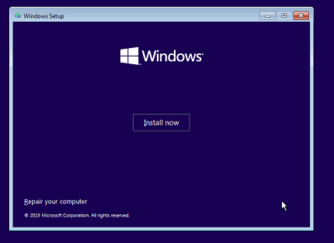
Install Windows 10 in VM (10)
Click Install now

Slide 37
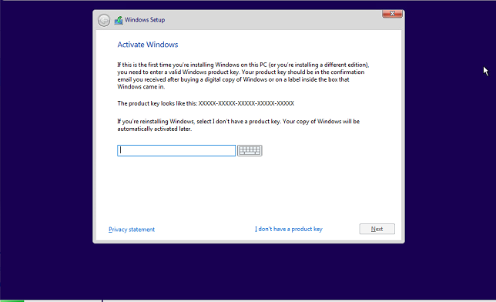
Install Windows 10 in VM (11)
Provide key that you stored in the text file

Slide 38
Install Microsoft Visual Studio
Both Windows and Mac OS users

Slide 39
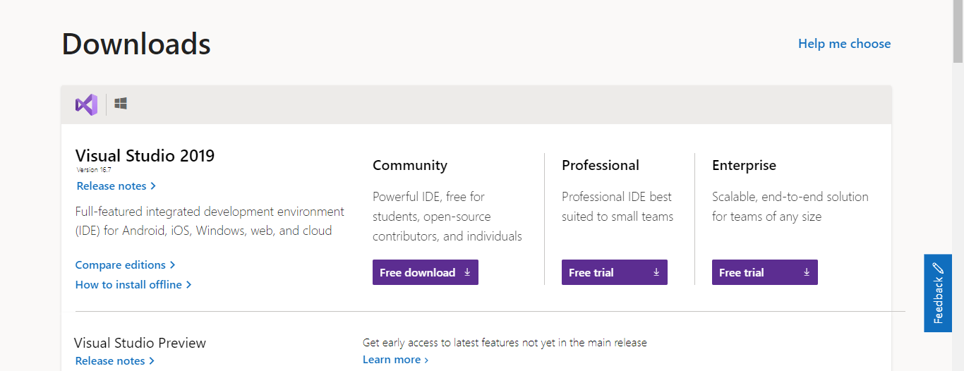
Visual Studio Setup
Go to : https://visualstudio.microsoft.com/vs/older-downloads/
Choose the Community edition - free download

Slide 40
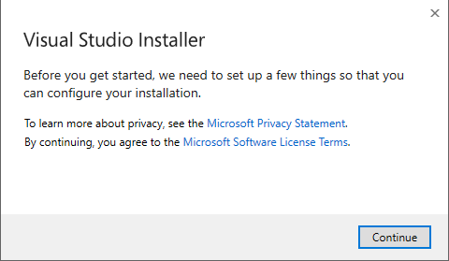
Visual Studio Setup
Double Click the installer
Click Continue button
Click Continue

Slide 41
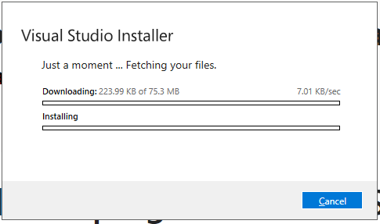
Visual Studio Setup
It will start downloading files

Slide 42
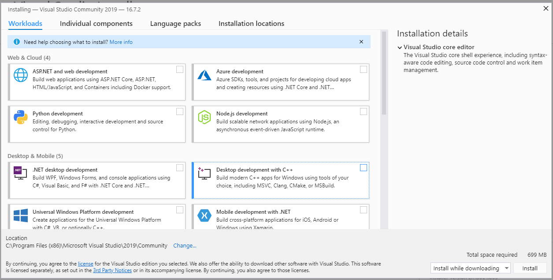
Visual Studio Setup
Check mark both .Net Desktop development and Desktop development with C++

Slide 43
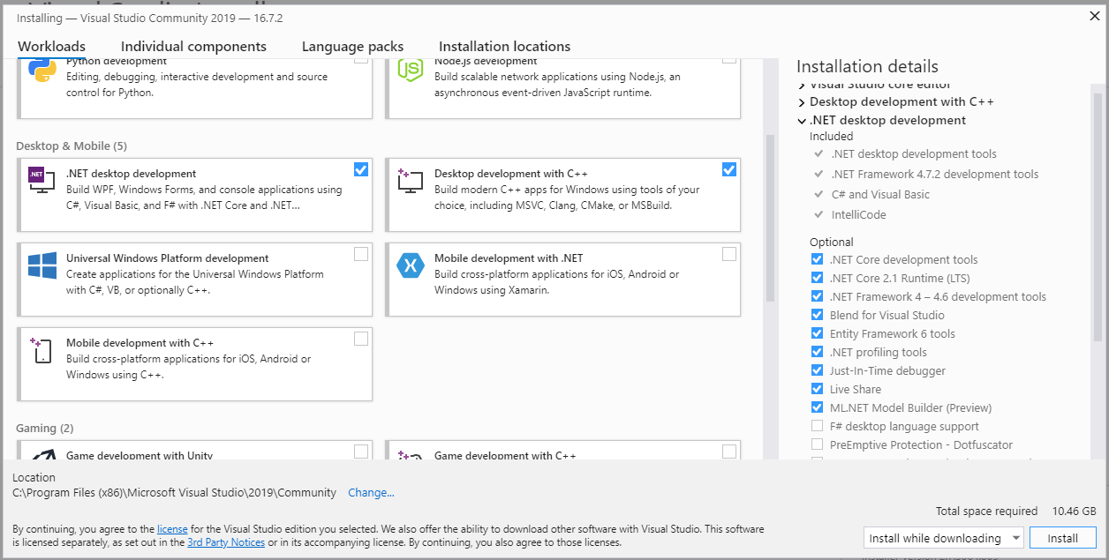
Visual Studio Setup
Click install

Slide 44
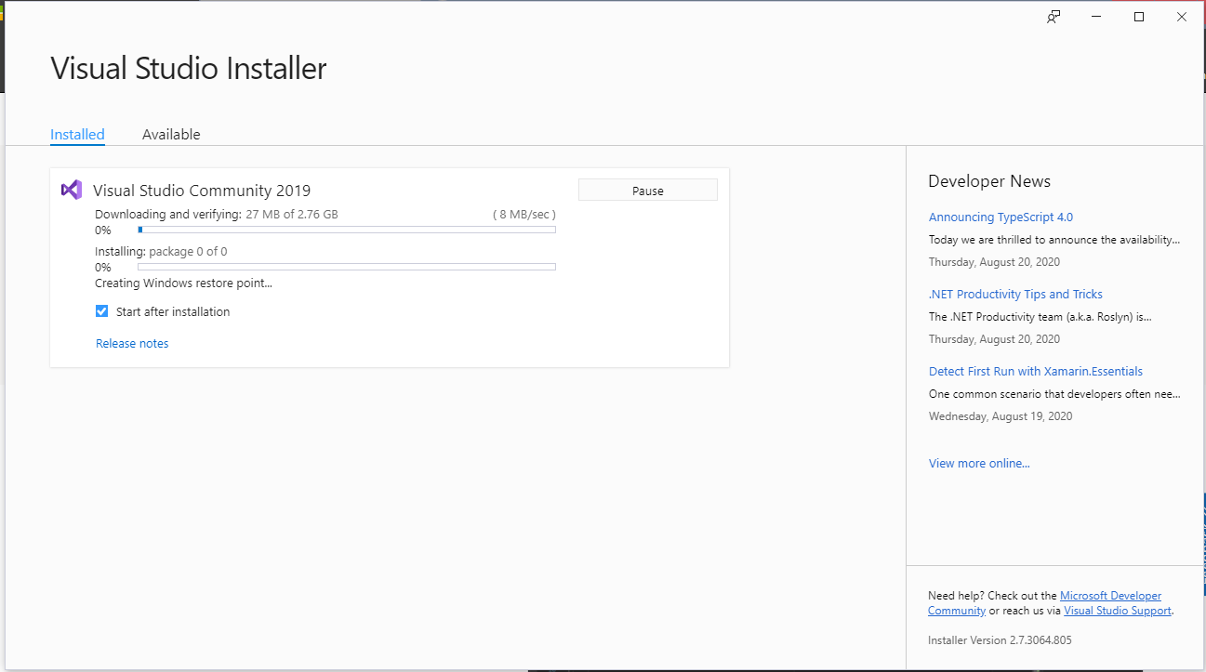
Visual Studio Setup
It will take some time to download the files, depending on your internet speed.

Slide 45
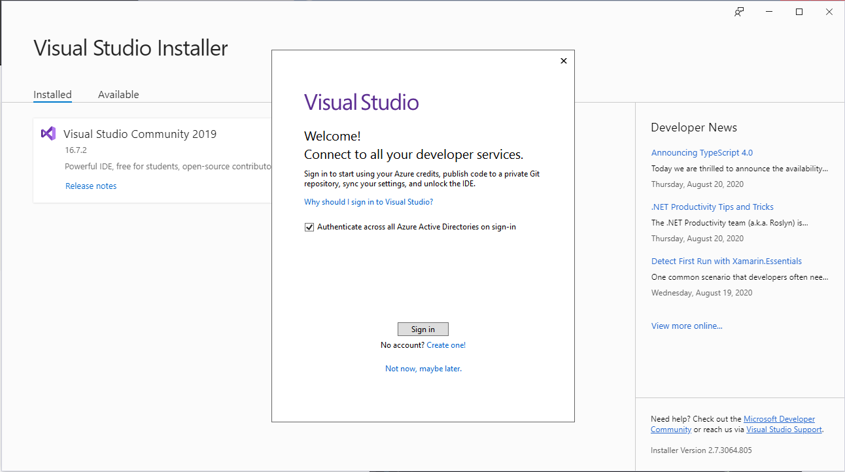
Visual Studio Setup
Sign in with your Microsoft account
Username
Password

Slide 46
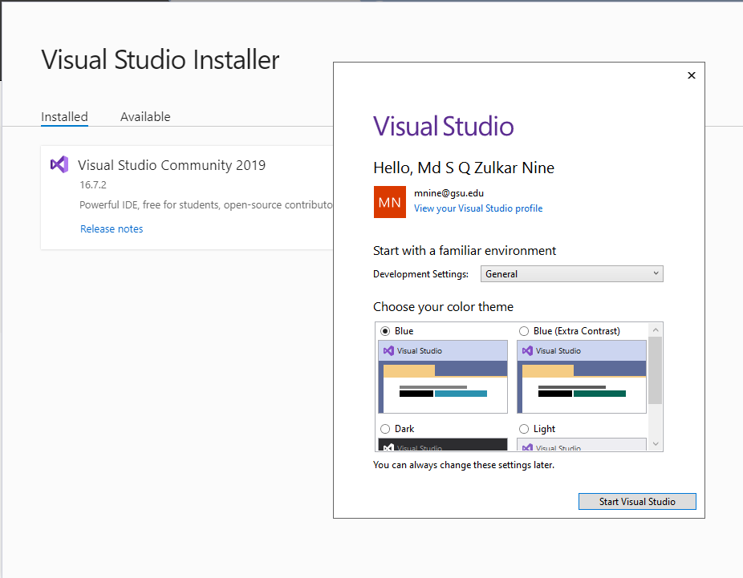
Visual Studio Setup
Start visual Studio

Slide 47
Some Math Recap …

Slide 48
Examples
Binary | Hex
0000 | 0
0001 | 1
0010 | 2
0011 | 3
0100 | 4
0101 | 5
0110 | 6
0111 | 7
1000 | 8
1001 | 9
1010 | A
1011 | B
1100 | C
1101 | D
1110 | E
1111 | F
Example 1: Convert Binary to Hexadecimal
Convert 10010010110101 to Hex
Solution:
1) Segment bits as a group of 4 bits from the right side.
10 0100 1011 0101
2) Pad with 0’s when the left most group doesn’t have 4 bits
3) Convert each group into hexadecimal digits using
the table : 24B5
0010 | 0100 | 1011 | 0101

Slide 49
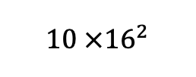
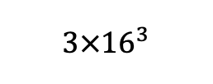
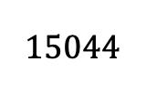
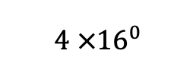
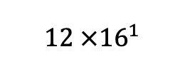
Examples
Example 2: Convert Hexadecimal to Decimal
Convert 3AC4 to decimal
Solution:
3 A C 4
$3×{16}^{3}$
+
$10 ×{16}^{2}$
+
+
=
$15044$
$12 ×{16}^{1}$
$4 ×{16}^{0}$

Slide 50
Examples
Example 3: Convert the following number into two’s compliment form.
Convert 00010110 into 2’s Complement form
Solution:
Flip all the bits (0 to 1, 1 to 0)
11101001 (This is 1’s complement)
2) Add 1 to the 1’s complement
11101001
+ 1
11101010 (This is 2’s complement)

Slide 51

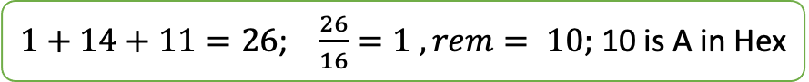







Examples
Example 4: Hexadecimal Addition
3AE8 + 9FBA = ?
carry 1 1 1
3 A E 8
2 F B A
6 A A 2
$8+10=18$; $\frac{18}{16}=1 , rem 2$
$1+14+11=26$; $\frac{26}{16}=1 , rem= 10;$ 10 is A in Hex
$1+10+15=26$; $\frac{26}{16}=1 , rem=10;$ 10 is A in Hex
$1+3+2=6$; 6 is 6 in Hex

Slide 52
Examples
Binary | Octal
000 | 0
001 | 1
010 | 2
011 | 3
100 | 4
101 | 5
110 | 6
111 | 7
Example 1: Convert Binary to Octal
Convert 10100011101 to Octal
Solution:
1) Segment bits as a group of 3 bits from the right side.
10 0100 1011 0101
2) Pad with 0’s when the left most group doesn’t have 4 bits
3) Convert each group into Octal digits using
the table : 2 4 3 5
010 | 100 | 011 | 101

Slide 53
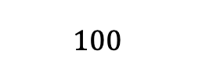

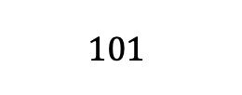

Example : Octal to Binary Conversion
Binary | Octal
000 | 0
001 | 1
010 | 2
011 | 3
100 | 4
101 | 5
110 | 6
111 | 7
Convert 2435 to Binary
2 4 3 5
$$010$$
$$100$$
$$011$$
$$101$$

Slide 54

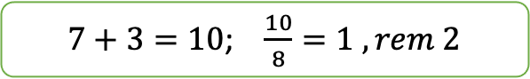

Octal addition
Add two octal numbers :
567 + 123 = ?
Carry. 1 1
5 6 7
1 2 3
7 1 2
$7+3=10$; $\frac{10}{8}=1 , rem 2$
$1+6+2=9$; $\frac{9}{8}=1 , rem 1$
$1+5+1=7$;

Slide 55
Practice at home
Number conversion among binary, hexadecimal, octal
Addition, subtraction different number systems.

Slide 56
Lab 1 (b) : Basic Concepts
Submission instructions

Slide 57
Lab 1 (b) : Submission
Solve the Problems provided in slide 57 to 59.
You can do your work in a text editor (Microsoft word, open office, etc.)
Or you can do it in a piece of paper, then scan or take a picture of the paper.
Convert them into pdf and submit in the icollege.

Slide 58
Lab 1 (b): Problem 1
Subtract the following hexadecimal numbers
7ACD - 3A8C = ?
Show the computation in details with all the carries. Result should be Hexadecimal

Slide 59
Lab 1 (b) Problem 2
Convert 01110110 into 2’s Complement form.

Slide 60
Lab 1 (b) Problem 3
Subtract the following Octal numbers
765 – 321
Show the steps with carries. Result is a octal number

